Slide 1
MIS 321
Strategy Practice

Slide 2
Background
This lab will provide an opportunity to:
Practice inheritance
Encapsulate behaviors using composition and interfaces
The lab is to simulate creating baseball pitchers for a game to be developed later.
** This lab is practice only and will not be submitted for a grade.

Slide 3
Step 1
Create a new Pitcher class
The class should have a Name, Team, and Throws property
The class should have a Pitch method that states the pitch has been thrown
The method should be virtual so it can be overridden by a sub class
In main instantiate a Pitcher object and call the Pitch method
Expected output… “The pitch has been thrown”

Slide 4
Step 2
Various pitchers have common traits. Let’s create a sub class of pitcher called Lefty
Lefty should extend Pitcher
Set the Throws property to “Left” when the constructor is called
Override the Pitch method to say “A curveball was thrown”
In main instantiate a 2nd Pitcher object and call the Pitch method
Expected output
The pitch has been thrown
A curveball was thrown

Slide 5
Pitching Behavior
In reality every pitcher uses multiple pitches. In fact pitchers are often working to develop new versions of existing pitches. We do not want to have to update the Pitcher or Lefty class every time a pitcher adds a new pitch.
Let’s encapsulate that behavior!!

Slide 6
Step 3
Add a new interface called IPitch
Require the Pitch method
Add a new class called Fastball
Fastball should implement the IPitch interface
The pitch method should display a 94mph fastball was thrown
Add a new class called Curveball
Curveball should implement the Ipitch interface
The pitch method should display an 80mph curveball was thrown

Slide 7
Step 3 Continued
Update the Pitcher class
Remove the Pitch method
Add an Ipitch field called pitchBehavior
Add a setter method for pitchBehavior
Add a no arg constructor
Set pitchBehavior = new Fastball in the constructor
Update the Lefty Class
Delete the Pitch method
Set pitchBehavior = new Curveball in the constructor

Slide 8
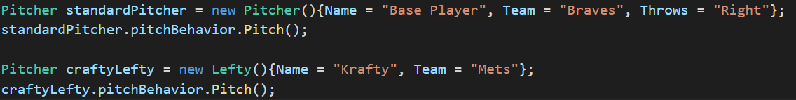
Step 3 Continued
Update main method to look something like this:
Expected Output
A 94mph fastball was thrown
An 80mph curveball was thrown

Slide 9
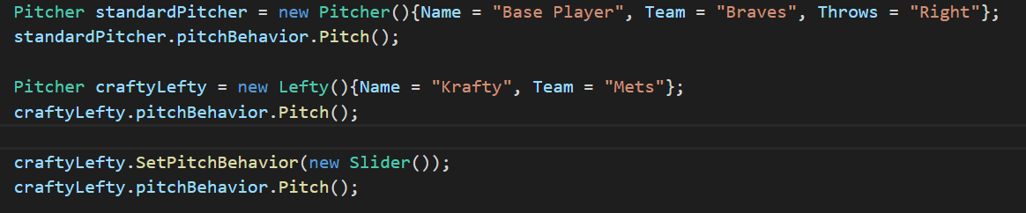
Step 4
Let’s add a new pitch!
Add a new slider class
The pitch method should read an 88mph slider was thrown
Call the setter in main to update the pitchBehavior for the Lefty and throw the pitch
Expected Output
A 94mph fastball was thrown
An 80mph curveball was thrown
an 88 mph slider was thrown

Slide 10
Step 5
Let’s simulate an at bat!
Let’s start main from scratch
Create temp variables for a fastball, curveball, and slider in main
Instantiate the craftyLefty pitcher
Throw the curve, then write that was a strike!
Throw a fastball, then write that was a strike!
Throw a slider, then write that was a ball
Throw a curve, then write strike 3, batters out!

Slide 11
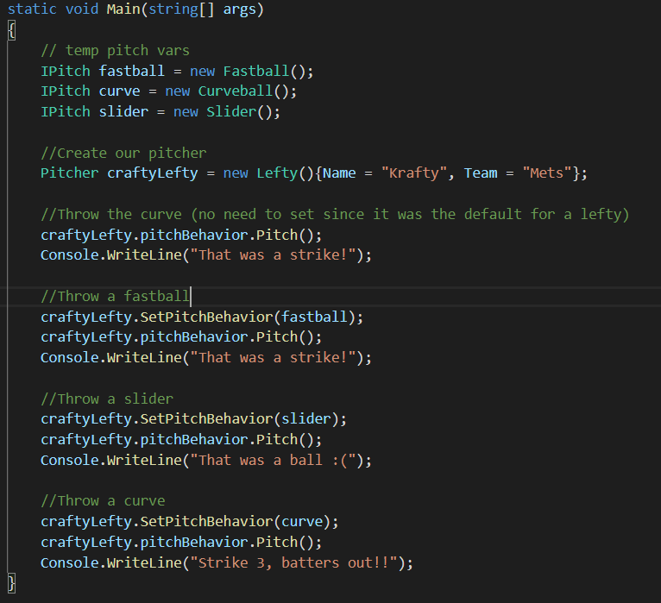
Final Output
Expected Output
An 80mph curveball was thrown
That was a strike!
A 94mph fastball was thrown
That was a strike!
an 88 mph slider was thrown
That was a ball :(
An 80mph curveball was thrown
Strike 3, batters out!!

